Slide 1


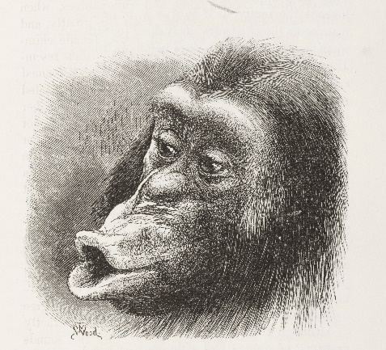
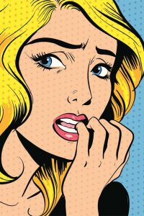
Welcome to Developing Emotions!
A Series of Lessons about Feelings and Emotions

Slide 2
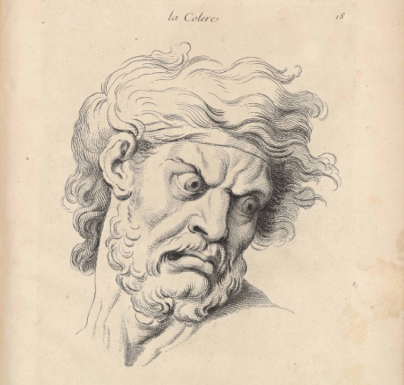
Week 1. Lesson 1.
Introducing “Developing Emotions”
These lessons are about feelings and emotions – past and present – in adults, children, and even animals!
Before we start, there are two short questionnaires to fill in, for us to discover how much you already know. Thank-you for completing them.

Slide 3
Discussion
What is an emotion?

Slide 4
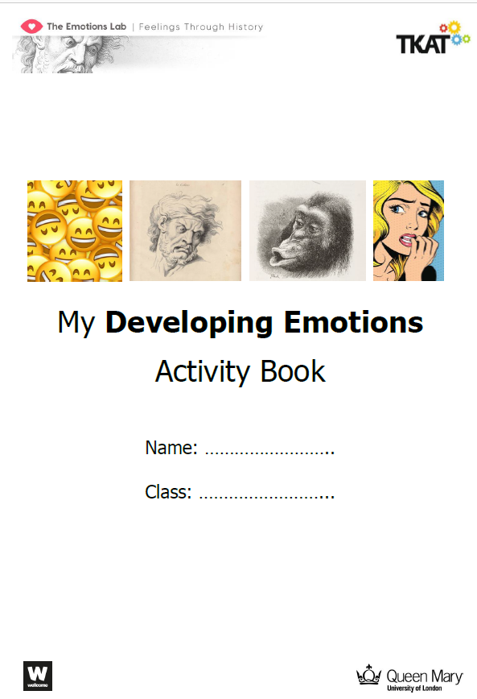
Meet your
Developing Emotions
Activity Book

Slide 5
Please complete
pages 5 and 6
of your book

Slide 6
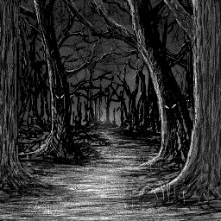
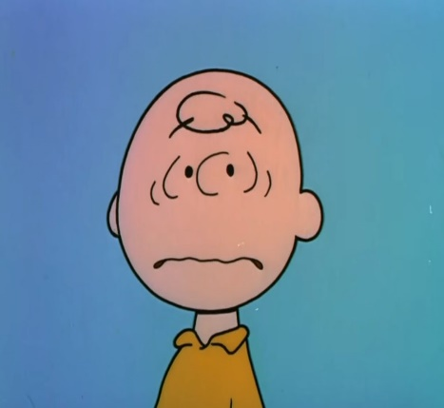
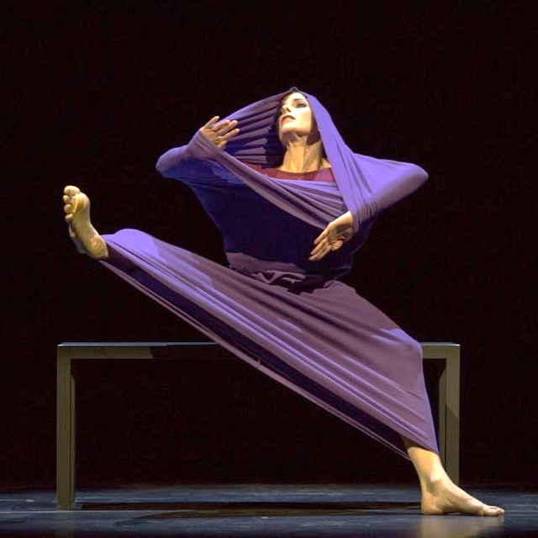
Developing Emotions
Fears and Worries

Slide 7
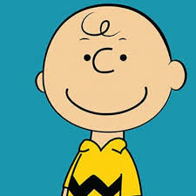
Week 1. Lesson 2
Picturing Worry
Charlie Brown is one of the most loved cartoon characters of all time.
One reason he’s popular is that he’s what’s called an ‘everyman’ character.
This means that he represents an ordinary kind of person - someone like us!

Slide 8
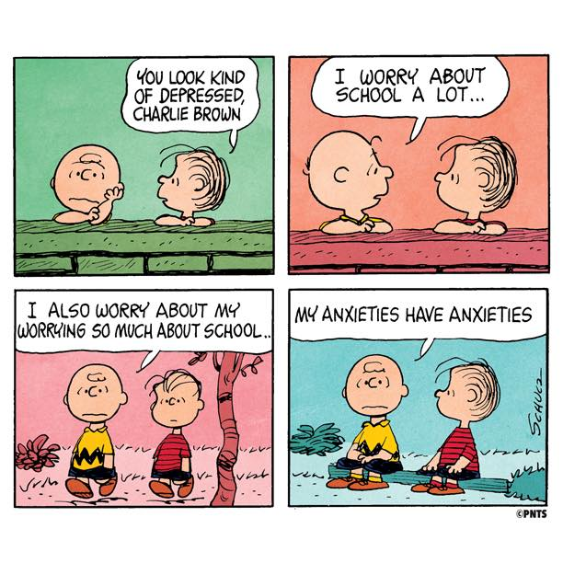
What are Charlie Brown and his friend feeling in these comic strips, and why?...

Slide 9
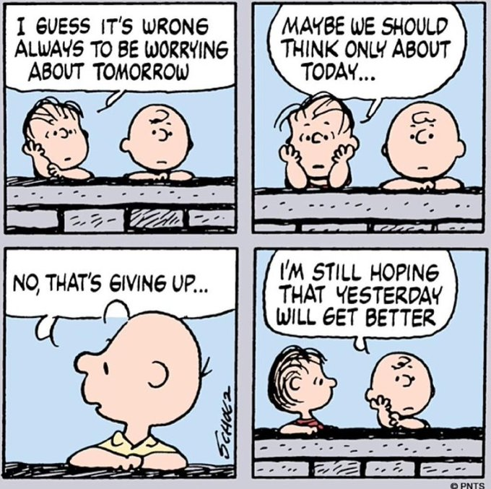
What are Charlie Brown and his friend feeling in these comic strips, and why?...

Slide 10
Can you think of any other kinds of everyday worry?
Write 3 examples of everyday worries in the space on page 9 of your book.

Slide 11
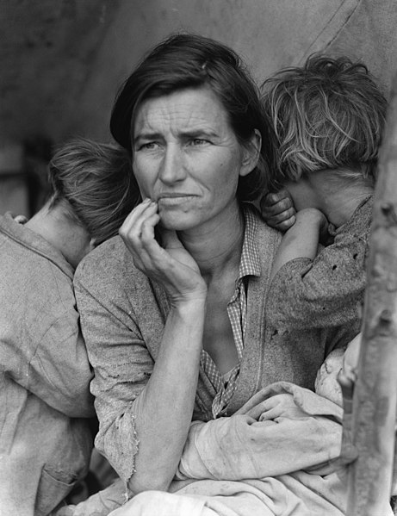
Although we feel like our worries are inside us, they are often a reaction to what’s going on in the world around us.
What kind of events or situations might make people worried?

Slide 12
Why are they worried?
In your groups, look carefully at one of the pictures on pages 10 and 11.
Try and think up as many different ideas as you can about why the person or people in your picture are feeling worried…

Slide 13
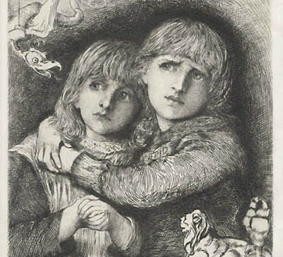
The Babes in the Wood
Sir Hubert Von Herkomer
(1881)

Slide 14
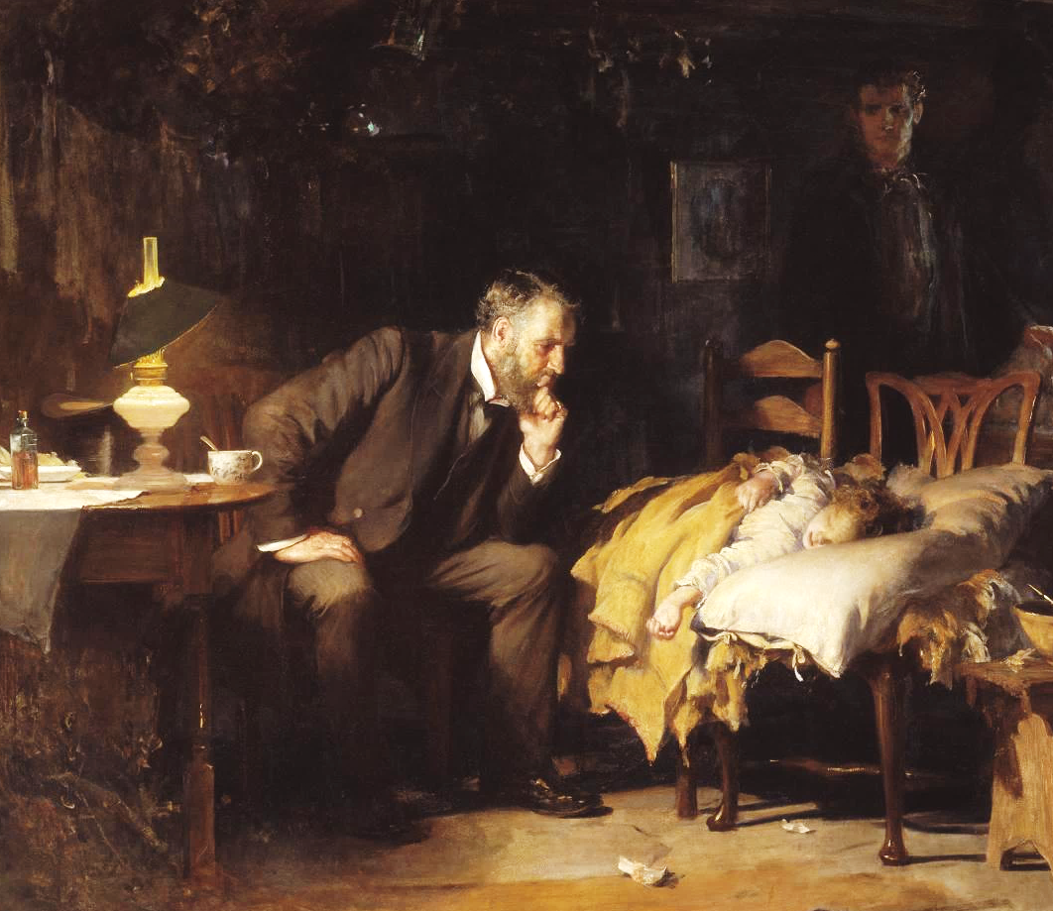
The Doctor
Sir Luke Fildes
(1891)

Slide 15
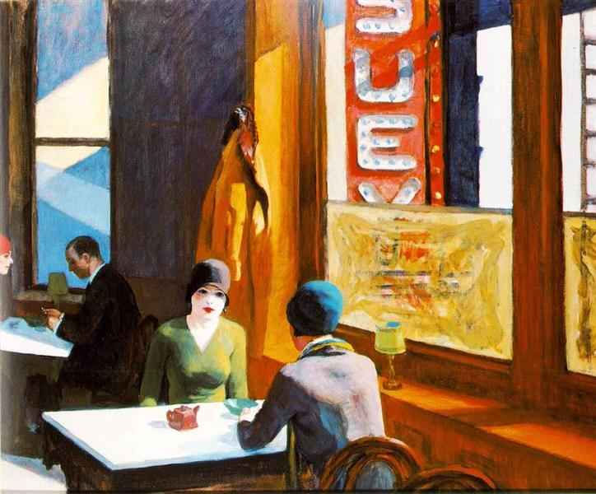
Chop Suey
Edward Hopper (1929)

Slide 16
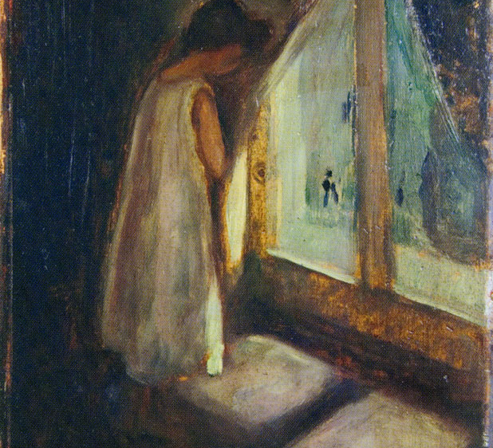
The Girl by the Window
Edvard Munch
(1897)

Slide 17
Migrant Mother
Dorothea Lange
(1936)

Slide 18
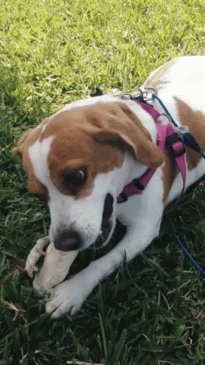
Now we’re going to take a closer look at words for worry.
Centuries ago, to worry meant to strangle!
As well as worrying about something, you can worry at something…which means repeatedly shaking, pulling, or biting something…like a dog with a bone!
On the next slide are some more worried words and their meanings. But they have been mixed up. Can you match each word with the correct meaning?

Slide 19
Match the word to its meaning
Anxious
Apprehensive
Concerned
Tense
Timid
Worried about something in the future, unsure how it will turn out
Unable to relax, with tightness in the body, especially the muscles
Feeling troubled and uneasy about things; sometimes felt in your body
Easily scared, or shy and lacking confidence
Worried about something or someone you care about

Slide 20
Do any of these words describe the picture you were looking at?
Do you know any other words for fear and worry that seem to fit?
Pick the best words to describe what might be going on in your picture, and write them down next to the picture.

